Slide 1
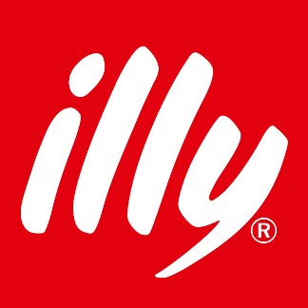
Illy Coffee
Business Case II
Billy Sagala

Slide 2
Case Background
Andrea Illy as CEO of Global Premium Coffee company, has dream that coffee market might be transform into something approaching the market of wine. Where connoisseurs discuss the fine points of various origin coffees and blends, where customers are willing to pay a premium for the finest examples of the coffee-making art, and where the growers, roasters and baristas will be compensated fairly for the expertise they contribute to every cup.
The current coffee market differs from such idelas, as coffee growers in most parts of the globe work at barely subsistence level.

Slide 3
Problem Identification
The problem identified as the gap between current coffee market and Illy vision to leverage specialty coffee market also equitable supply chain between Coffee Grower, Roasters, Barista and Customers together and coffee better tasting.
The goal is to solidify the beginning of Coffee Market’s third wave that every coffee came with a story of its origins and growers could counts on occasionally eye-popping premium for their beans.

Slide 4
Business Component That Need Improvement
Operation - Growers
Growers needs to be trained to maintain quality standard on Coffee Bean grow that meet Illy’s Coffee quality.
Supply Chain
Marketing
Leverage Illy’s coffee branding as sustainable and equitable premium coffee.
Researching and find innovation to improve coffee quality, both in grow field, and delivery.
Research and Development
Managing effective supply chain that profitable for company and growers.

Slide 5
Transformation Needed
To help company strife in the market, Illy Coffee needs:
Bottom – Up Approach starting by transforming process and practices of Growers to achieving quality Coffee bean. The transformation that started from growers will initiate the transformation of whole coffee delivery process in the supply chain, roasting, to the hand of customers.

Slide 6
New Product Proposal
Segmenting
Targeting
Premium Coffee lover who is willing to pay high price to afford coffee’s quality
Positioning
Illy positioning as leveraged Coffee brand that provide Premium Coffee Product with equitable Supply Chain from Growers, Roaster and Customers.
Premium Coffee Lover that looking for High Quality Specialty Coffee and provide equitable supply chain.

Slide 7
New Product Proposal
The New Coffee Product proposed named Lima Nusantara.
Lima Nusantara is Specialty Mixture of Five Indonesia’s quality monitored bean (https://javacoffeeiq.com/5-most-popular-coffee-beans-from-indonesia/):
Gayo, Kintamani, Bajawa, Java, Toraja
Illy’s will monitor quality of each bean starting from the grower. Lima Nusantara will be available worldwide, to support Indonesia’s coffee growers.

